Slide 1
JavaScript
IN432
Advanced technologies of WEB

Slide 2
Overview
  Primitives, Operations, and Expressions
  Screen Output and Keyboard Input
  Control Statements
  Object Creation and Modification
  Arrays
  Functions

Slide 3
Overview
It is a real language
Small, but sophisticated
It is not a subset of Java
Is dynamically typed
Case sensitive

Slide 4
Where to put the code ?
Either directly, as in
<script type = "text/javaScript">
-- JavaScript script –
</script>
Or indirectly, as a file specified in the src attribute of <script>, as in
<script type = "text/javaScript"
src = "myScript.js">
</script>

Slide 5
Variables & Primitives Values
Variables can be declared implicitly or explicitly
  var sum = 0,today = "Monday",
  flag = false;
Numbers
Strings
Booleans
null
undefined
Number, String, Boolean have wrapper objects
Notes:
console.log(Number("123")); // 123 (string → number)
console.log(Number("123abc")); // NaN (invalid string)
console.log(Number(true)); // 1
console.log(Number(false)); // 0
console.log(Number(null)); // 0
console.log(Number(undefined)); // NaN
console.log(Number("")); // 0
// Similar with + operator
console.log(+"456"); // 456
console.log(+"abc"); // NaN
console.log(Number.MAX_VALUE); // 1.7976931348623157e+308
console.log(Number.MAX_VALUE * 2); // Infinity
console.log(Number("hello")); // NaN
console.log(Math.sqrt(-1)); // NaN
console.log(typeof NaN); // "number"
console.log(Number.POSITIVE_INFINITY); // Infinity
console.log(1 / 0); // Infinity

Slide 6
NaN
Special number: Not a Number
Result of undefined or erroneous operations
Toxic: any arithmetic operation with NaN as an input will have NaN as a result
NaN is not equal to anything, including NaN

Slide 7
Number function
  Number(value)
Converts the value into a number.
It produces NaN if it has a problem.
Similar to + prefix operator.
Some useful properties:
  MAX_VALUE, MIN_VALUE, NaN,
  POSITIVE_INFINITY, NEGATIVE_INFINITY
  e.g., Number.MAX_VALUE

Slide 8
parseInt function
  parseInt(value, 10) or parseFloat(value)
Converts the value into a number.
It stops at the first non-digit character.
The radix (10) should be required.
parseInt("08") === 0
parseInt("08", 10) === 8
Notes:
parseInt(value, radix)
Converts a string into an integer.
radix means the base (10 = decimal, 16 = hexadecimal, etc.).
If you don’t provide radix, older JavaScript engines sometimes guessed wrong (e.g., "08" was read as octal → 0).
✅ That’s why you should always specify 10 for decimal numbers.
console.log(parseInt("45px", 10)); // 45
console.log(parseInt("px45", 10)); // NaN

Slide 9
Math
Math object is modeled on Java's Math class.
It contains
  abs absolute value
  floor integer
  log logarithm
  max maximum
  pow raise to a power
  random random number
  round nearest integer
  sin sine
  sqrt square root
  ……

Slide 10
String length
string.length
The length property determines the number of 16-bit characters in a string.

Slide 11
String function
  String(value) or toString()
Converts value to a string
If something is added (+) with string → converted to string

Slide 12
String Methods
charAt → str.charAt(3)
concat
indexOf → str.indexOf(‘B’), str.indexOf(“Hello”)
lastIndexOf
match
replace
search
slice → extract a part of a string
split
substring → str.substring(from, to)
toLowerCase
toUpperCase
Notes:
match
Where you see it: Often in JavaScript, match() is a method of String.
Purpose: Used to check if a string matches a given regular expression and to return the result of the match.
Return type: An array of matches if found, or null if no match.
let text = "hello world";
console.log(text.match(/world/));
// → ["world"]
console.log(text.match(/abc/));
// → null
So match is about pattern matching, not comparing values.
Use slice() if you want flexibility (supports negatives, works like array slice).
Use substring() if you just want a simple, safe substring (but less powerful).

Slide 13
Booleans
true
false

Slide 14
Boolean function
  Boolean(value)
returns true if value is truthy
returns false if value is falsy

Slide 15
NaN
A value that isn't anything
NaN is not == to any number, not even itself
Test for it with isNaN(x)
console.log(0 / 0); // NaN
console.log(parseInt("x")); // NaN
console.log(typeof NaN); // "number"
Notes:
NaN
Type: number
Meaning: Stands for Not-a-Number. It’s the result of invalid math operations.
console.log(0 / 0); // NaN
console.log(parseInt("x")); // NaN
console.log(typeof NaN); // "number"

Slide 16
undefined
A value that isn't even that
The default value for variables and parameters
The value of missing members in objects

Slide 17
Falsy values
false
null
undefined
"" (empty string)
0
NaN
All other values (including all objects) are truthy.
"0" "false"

Slide 18
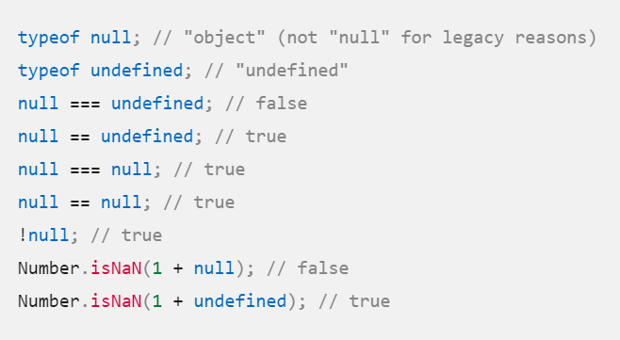
NaN , null , undefined
Notes:
null is converted to a number when used in arithmetic.
Number(null) → 0

Slide 19
Coercion: implicit conversion
Context / Operator | Rule
+ (with string) | Converts other operand → string
-, *, /, % | Converts operands → number
Conditional (if, while) | Converts to boolean (truthy/falsy)
== (loose equality) | Converts both sides to a common type
`

Slide 20
Coercion: implicit conversion
"5" + 2 // "52" (number 2 coerced to string → concatenation)
"5" - 2 // 3 (string "5" coerced to number → subtraction)
true + 1 // 2 (true coerced to number 1)

Slide 21
== Loose equality
Compares after type coercion.
If types differ, JavaScript tries to convert them before comparing.
5 == "5" // true ("5" coerced to number 5)
0 == false // true (false coerced to 0)
null == undefined // true (special case)

Slide 22
===→ strict equality(safe)
Compares without type coercion.
Values must be of the same type and value to be equal.
5 === "5" // false (number vs string)
0 === false // false (number vs boolean)
5 === 5 // true (same type, same value)

Slide 23
Everything Else Is Objects

Slide 24
Dynamic Objects
Unification of Object and Hashtable
new Object() produces an empty container of name/value pairs
  A name can be any string, a value can be any value except undefined
members can be accessed with dot notation or subscript notation
No hash nature is visible (no hash codes or rehash methods)
Notes:
🔸 Unification of Object and Hashtable
In JavaScript, an Object is essentially a hashtable (or dictionary): it stores data as a set of key–value pairs.
Unlike in some languages where hashtable and object are different concepts, in JavaScript they are unified — the Object type itself serves this purpose.

Slide 25
Dynamic Objects
let person = {
"first name": "Alice",
"last-name": "Smith",
age: 25
};
// Access values
console.log(person["first name"]); // "Alice"
console.log(person["last-name"]); // "Smith"
// Using a variable as a key
let key = "age";
console.log(person[key]); // 25
// Update value
person["age"] = 26;
console.log(person["age"]); // 26

Slide 26
Identifiers
Starts with a letter or _ or $
Followed by zero or more letters, digits, _ or $
By convention, all variables, parameters, members, and function names start with lower case
  Except for constructors which start with upper case

Slide 27
Reserved Words
  abstract
  boolean break byte
  case catch char class const continue
  debugger default delete do double
  else enum export extends
  false final finally float for function
  goto
  if implements import in instanceof int interface
  long
  native new null
  package private protected public
  return
  short static super switch synchronized
  this throw throws transient true try typeof
  var volatile void
  while with

Slide 28
Comments
  // slashslash line comment
  /*
  slashstar
  block
  comment
  */

Slide 29
Operators
Arithmetic
  + - * / %
Comparison
  == != < > <= >=
Logical
  && || !
Bitwise
  & | ^ >> >>> <<
Ternary
  ?:
All operations are in double precision
Same precedence and associativity as Java

Slide 30
+
Addition and concatenation
If both operands are numbers,
  then
    add them
else
    convert them both to strings
    concatenate them
'$' + 3 + 4 = '$34'

Slide 31
+
Unary operator can convert strings to numbers
  +"42" = 42
Also
  Number("42") = 42
Also
  parseInt("42", 10) = 42
  +"3" + (+"4") = 7

Slide 32
== !=
Equal and not equal
These operators can do type coercion
It is better to use === and !==, which do not do type coercion.

Slide 33
&&
The guard operator, aka logical and
If first operand is truthy
  then result is second operand
  else result is first operand
It can be used to avoid null references
  if (a) {
    return a.member;
  } else {
    return a;
  }
can be written as
  return a && a.member;

Slide 34
||
If first operand is truthy
  then result is first operand
  else result is second operand
It can be used to fill in default values.
  var last = input || nr_items;
(If input is truthy, then last is input, otherwise set last to nr_items.)

Slide 35
!
Prefix logical not operator.
If the operand is truthy, the result is false. Otherwise, the result is true.
!! produces booleans.
  it forces conversion to a real boolean (true or false).
    console.log(!true); // false
    console.log(!false); // true
    console.log(!!123); // true
    console.log(!!0); // false
Notes:
Prefix Logical NOT (!)
The ! operator is the logical NOT.
It coerces the operand to a boolean and then inverts it.
Rules:
If the operand is truthy, result → false.
If the operand is falsy, result → true.
Double Logical NOT (!!)
Applying ! twice:
First ! converts the value to a boolean and inverts it.
Second ! inverts it back.
👉 Effect: it forces conversion to a real boolean (true or false).
! → negates a truthy/falsy value (always gives a boolean).
!! → common trick to coerce any value into a strict boolean.
console.log(!true); // false
console.log(!false); // true
console.log(!"hello"); // false (non-empty string is truthy)
console.log(!""); // true (empty string is falsy)
console.log(!0); // true (0 is falsy)
console.log(!123); // false (non-zero is truthy)
console.log(!null); // true
console.log(!undefined); // true
console.log(!NaN); // true
console.log(!!"hello"); // true
console.log(!!""); // false
console.log(!!123); // true
console.log(!!0); // false
console.log(!!null); // false
console.log(!!undefined); // false
console.log(!!NaN); // false
!value → "Is this value falsy?" (gives the opposite as a boolean).
!!value → "Convert this value into a pure boolean (true/false)".

Slide 36
Bitwise
  & | ^ >> >>> <<
The bitwise operators convert the operand to a 32-bit signed integer and turn the result back into 64-bit floating point.

Slide 37
typeof operator
  typeof(variable)
Returns:
  "number“ for Number
  "string“ for String
  "boolean" for Boolean
  "undefined" for Undefined
  "function" for functions, and
  "object" for objects and NULL

Slide 38
typeof
The typeof prefix operator returns a string identifying the type of a value.
type | typeof
object | 'object'
function | 'function'
array | 'object'
number | 'number'
string | 'string'
boolean | 'boolean'
null | 'object'
undefined | 'undefined'

Slide 39
Document and Window
Two main objects provided
  document → a reference on the actual web page
    Method write that dynamically creates content
    Ex: document.write(“<p>Hello: “ + name + “!!</p>”)
  window → a reference on the whole window
    window.alert
    window.confirm
    window.prompt

Slide 40
Screen output & keyboard input
  Using the Window object
window.alert(“message”)
  Message parameter is a text, opens a dialog box with OK button
window.confirm(“message”)
  This dialog is with two buttons: OK and Cancel
  If returned value == true → Ok, otherwise → cancel
window.prompt(“message”,”default value”)
  Ok and Cancel buttons
  Default value is returned when Ok pressed without inputting value

Slide 41
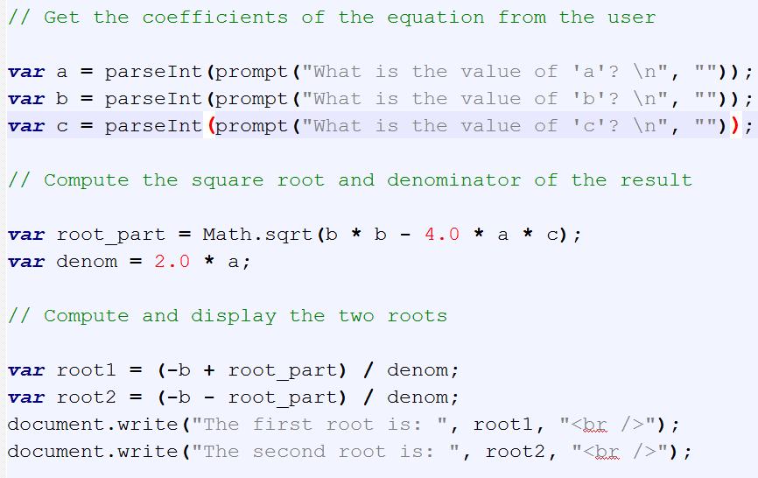
Screen output & keyboard input
Notes:
Window is the global object so..we can use prompt without window.

Slide 42
Date object
  Date Object
Create one with the Date constructor (no parameters)
Local time methods of Date:
  toLocaleString – returns a string of the date
  getDate – returns the day of the month
  getMonth – returns the month of the year (0 – 11)
  getDay – returns the day of the week (0 – 6)
  getFullYear – returns the year
  getTime – returns the number of milliseconds since January 1, 1970
  getHours – returns the hour (0 – 23)
  getMinutes – returns the minutes (0 – 59)
  getMilliseconds – returns the millisecond (0 – 999)

Slide 43
Statements
expression
  if
  switch
  while
  do
  for
  break
  continue
  return
  try/throw

Slide 44
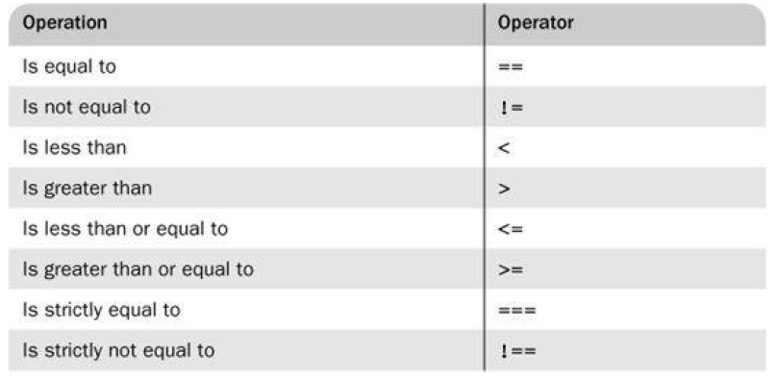
Comparison Operators

Slide 45
If statement
If…else statement
  if(a > b) {
    document.write(“a is greater than b<br/>”)
  else {
    a=b;
    document.write(“a was not greater than b <br/>”,
    “Now they are equal <br/>”);
  }

Slide 46
Switch statement
The switch value does not need to be a number. It can be a string, number, or Boolean.
The case values can be also expressions.
switch (expression) {
  case value_1:
    // value_1 statements
  case value_2:
    // value_2 statements
  …
  [default:
    // default statements]
}

Slide 47
Switch statement
switch (expression) {
case ';':
case ',':
case '.':
punctuation();
break;
default:
noneOfTheAbove();
}

Slide 48
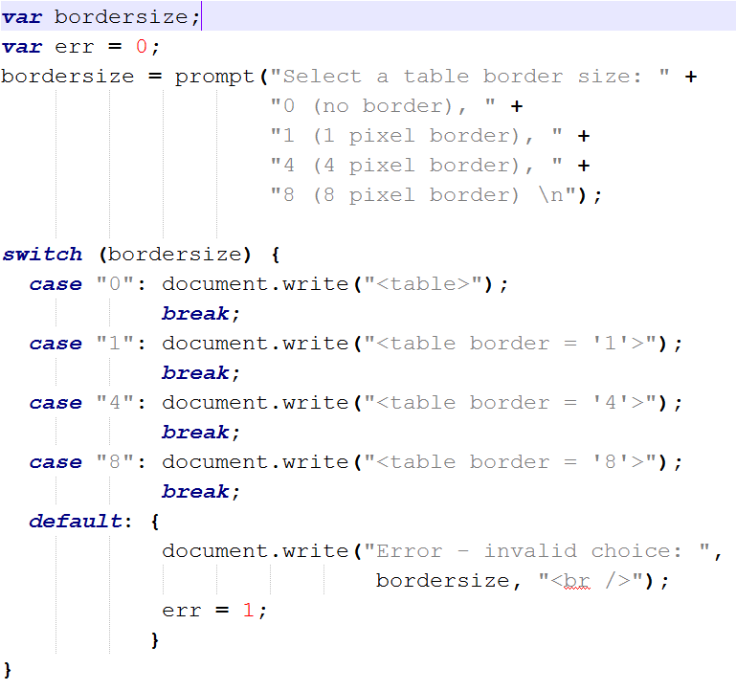
Switch statement

Slide 49
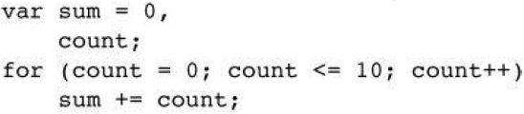
For statement
Iterate through all of the elements of an array:
for (var i = 0; i < array.length; i += 1) {
    // within the loop,
    // i is the index of the current member
    // array[i] is the current element
}

Slide 50
while & do..while statements
same as for statement:
while (condition) {
  //code block to be executed
}
do {
  // code to be executed
} while(condition);

Slide 51
while & do..while statements
while (i<5) {
  x=x + "The number is " + i + "<br>";
  i++;
}
do {
  x=x + "The number is " + i + "<br>“;
  i++;
} while (i<5);

Slide 52
Break statement
Statements can have labels.
Break statements can refer to those labels.
  loop: for (;;) {
    ...
      if (...) {
        break loop;
      }
    ...
  }
Notes:
outerLoop: for (let i = 1; i <= 3; i++) {
for (let j = 1; j <= 3; j++) {
if (i === 2 && j === 2) {
break outerLoop; // break out of BOTH loops
}
console.log(i, j);
}
}
console.log("Done!");

Slide 53
Object Creation & Modification
var myAirplane = new Object();
myAirplane.make = "Cessna";
myAirplane.model = "Centurian";
Objects can be nested, so a property could be itself another object, created with new
Properties can be accessed by dot notation or in array notation, as in
var property1 = myAirplane["model"];
To delete a property → delete myAirplane.model;

Slide 54
For statement : iterator
Iterate through all of the members of an object:
for (var name in object) {
  if (object.hasOwnProperty(name)) {
    // within the loop,
    // name is the key of current member
    // object[name] is the current value
  }
}
for (var prop in myAirplane)
  document.write(myAirplane[prop] + "<br />");

Slide 55
Try statement
  try {
  ...
  } catch (e) {
  switch (e.name) {
  case 'Error':
  ...
  break;
  default:
  throw e;
  }
  }

Slide 56
Try Statement
The JavaScript implementation can produce these exception names:
  'Error'
  'EvalError'
  'RangeError'
  'SyntaxError'
  'TypeError'
  'URIError'

Slide 57
Arrays
Array elements can be primitive values or references to other objects.
Length is dynamic → value is stored in length property
Indexes are converted to strings and used as names for retrieving values.
One advantage: No need to provide a length or type when creating an array.
Notes:
let arr = [42, "hello", true, { name: "Ali" }, [1, 2, 3]];

Slide 58
Arrays Creation
    var myCars=new Array(); → empty array
    myCars[0]="Saab"; myCars[1]="Volvo“; myCars[2]="BMW";
    var arr = new Array(24, “bread”, true) → array with literals
    var arr = [24, “bread”, true]; → without new;
    var arr = new Array(25); → here creates an element of 25 elements

Slide 59
Arrays: length, access
access
  arr[index] = value;
  or value = arr[index]
  assigning a value to an element that does not exist → creates it
length → length property
  = the highest subscript + 1
  can be set (ex: arr.length = 23;)
If you increase the length, new empty slots are added (with value undefined).
If you decrease the length, the array is truncated and data is permanently removed.
Notes:
How .length works
.length is not read-only. You can manually set it.
If you increase the length, new empty slots are added (with value undefined).
If you decrease the length, the array is truncated and data is permanently removed.
let arr = [10, 20, 30, 40, 50];
arr.length = 3; // cut the array
console.log(arr); // [10, 20, 30]

Slide 60
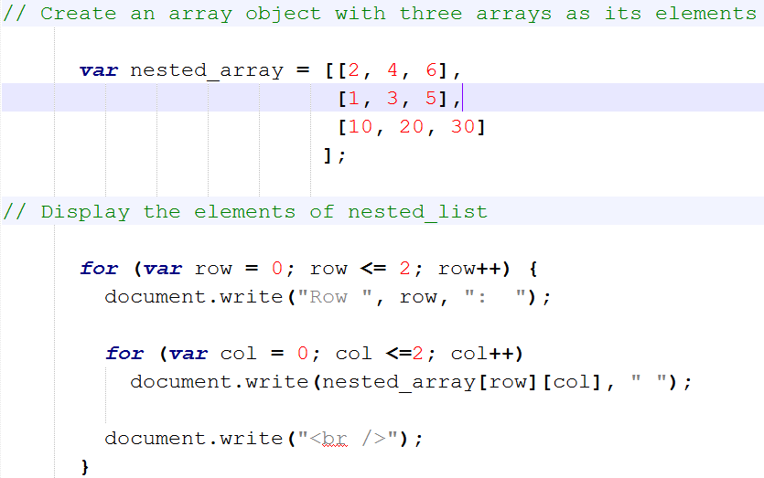
2D arrays

Slide 61
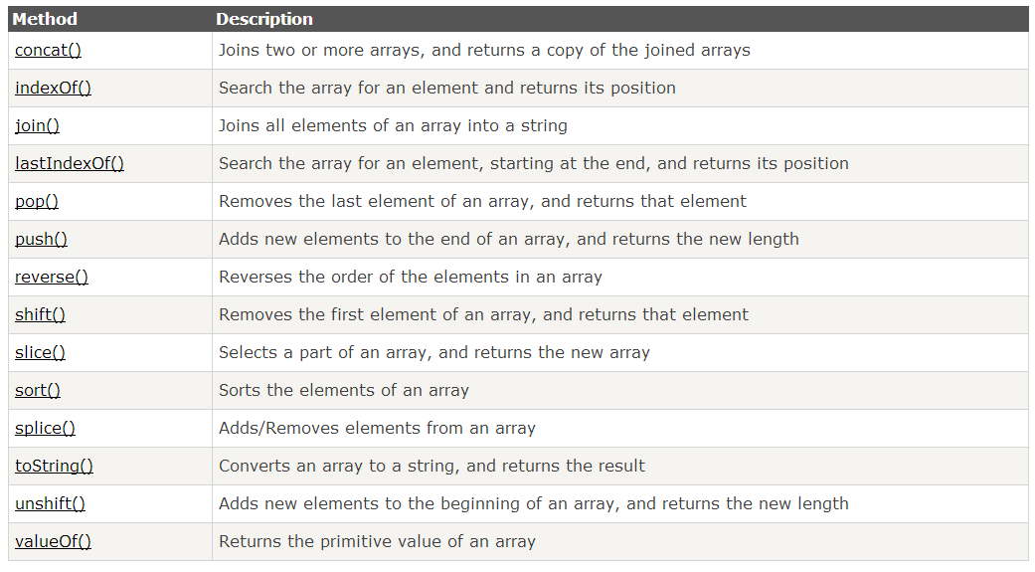
Array Methods

Slide 62
Array Methods
concat method
var list1= ["Cecilie", "Lone"];
var list2 = ["Emil", "Tobias", "Linus"];
var list = list1.concat(list2);
The values of the list array will be:
Cecilie,Lone,Emil,Tobias,Linus

Slide 63
Array Methods
indexOf method
var fruits = ["Banana", "Orange", "Apple", "Mango"];
var a = fruits.indexOf("Apple");
The result of a will be: 2

Slide 64
Array Methods
join method
var fruits = ["Banana", "Orange", "Apple", "Mango"];
var a = fruits.join (“:");
The result of a will be: "Banana:Orange:Apple:Mango"

Slide 65
Array Methods
push and pop methods
var fruits = ["Banana", "Orange", "Apple", "Mango"];
var a = fruits.pop();
The result of fruits will be: Banana,Orange,Apple
  a contains “Mango”
var newlength = fruits.push(“Kiwi”);
  fruits→[”Banana”, ”Orange”, ”Apple”, ”Mango”, ”Kiwi”]

Slide 66
Array Methods
reverse method
var fruits = ["Banana", "Orange", "Apple", "Mango"];
fruits.reverse();
The result of fruits will: Mango,Apple,Orange,Banana

Slide 67
Array Methods
shift and unshift methods
var fruits = ["Banana", "Orange", "Apple", "Mango"];
var a = fruits.shift();
  The result of fruits : Orange,Apple,Mango
  a contains “Banana”
var fruits = ["Banana", "Orange", "Apple", "Mango"];
var newlength = fruits.unshift("Lemon","Pineapple");
  The result of fruits: Lemon,Pineapple,Banana,Orange,Apple,Mango

Slide 68
Array Methods
splice method
array.splice(index,howmany,item1,.....,itemX)
  index → start index (required)
  howmany → how many elements to be removed (required)
  item1, item2,.. → list of items to be added if any (optional)
  if elements removed → they are returned
var fruits = ["Banana", "Orange", "Apple", "Mango"];
fruits.splice(2,0,"Lemon","Kiwi");
  The result of fruits: Banana,Orange,Lemon,Kiwi,Apple,Mango
  added two elements without removing any

Slide 69
Array Methods
slice method
var fruits = ["Banana", "Orange", "Apple", "Mango"];
var sublist1 = fruits.slice (1,3);
var sublist2 = fruits.slice(2);
  The result of sublist1 : Orange,Apple
  The result of sublist2 : Apple, Mango
  var fruits = ["Banana", "Orange", "Apple", "Mango"];

Slide 70
Array Methods
sort, valueOf, toString
var fruits = ["Banana", "Orange", "Apple", "Mango"];
var v = fruits.valueOf();
var str = fruits.toString();
  v contains a copy of fruits
  The result of str: Banana,Orange,Apple,Mango
fruits.sort();
  fruits become: “Apple”, “Banana", “Mango“, "Orange"

Slide 71
Deleting Elements
delete array[number]
Removes the element, but leaves a hole in the numbering.
array.splice(number, 1)
Removes the element and renumbers all the following elements.

Slide 72
Deleting Elements
myArray = ['a', 'b', 'c', 'd'];
delete myArray[1];
// ['a', undefined, 'c', 'd']
myArray.splice(1, 1);
// ['a', 'c', 'd']

Slide 73
Function statement
  function name(parameters) {
    statements;
  }

Slide 74
var statement
Defines variables within a function.
Types are not specified.
Initial values are optional.
  var name;
  var nrErrors = 0;
  var a, b, c;

Slide 75
Scope
In JavaScript, {blocks} do not have scope.
Only functions have scope.
Vars defined in a function are not visible outside of the function.

Slide 76
Return statement
  return expression;
or
  return;
If there is no expression, then the return value is undefined.
Except for constructors, whose default return value is this.

Slide 77
Call function
If fun is the name of a function,
  fun(); or
  var returnedvalue = fun();
Name of a function is like an object
ref_fun = fun;
fun(); → call the function
ref_fun(); /* A call to fun */

Slide 78
Call function
Parameters are passed by value
  if primitive → copy
  if object → copy of the reference (Then parameters are passed by Reference)
no check of type or number of parameters
  if number of parameters exceed → excess are ignored
  if number is less → completed by undefined

Slide 79
Call function
no way to send primitive variable by reference unless put in an array
function by10(a) {
a[0] *= 10;
}
...
var listx = new Array(1);
...
listx[0] = x;
by10(listx);
x = listx[0];

Slide 80
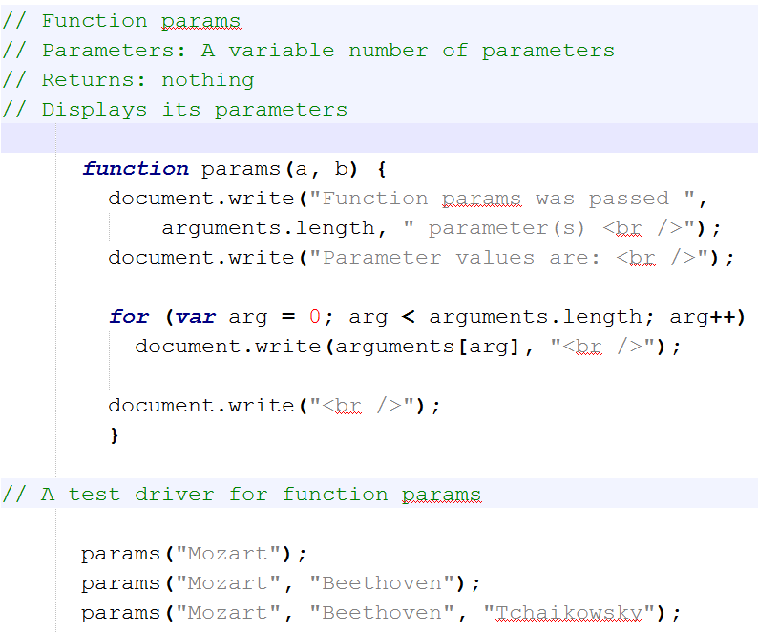

Slide 81
Back to sort method
To sort something other than strings into alphabetical order,
  write a function that performs the comparison
  send it to the sort method
The comparison function must return
  negative number → first is less than second
  zero → are equal
  positive number → first is greater than second
function num_order(a, b) {return a - b;}
  to sort an array named num_list
  num_list.sort(num_order); → sort based on a-b
Notes:
let people = [
{ name: "Alice", age: 25 },
{ name: "Bob", age: 20 },
{ name: "Charlie", age: 30 }
];
people.sort((a, b) => a.age - b.age);
console.log(people);
// [
// { name: "Bob", age: 20 },
// { name: "Alice", age: 25 },
// { name: "Charlie", age: 30 }
// ]

Slide 82
Back to sort method
let people = [
{ name: "Alice", age: 25 },
{ name: "Bob", age: 20 },
{ name: "Charlie", age: 30 }
];
people.sort((a, b) => a.age - b.age);
console.log(people);
// [
// { name: "Bob", age: 20 },
// { name: "Alice", age: 25 },
// { name: "Charlie", age: 30 }
// ]

Slide 83
Objects
Everything else is objects
Objects can contain data and methods
Objects can inherit from other objects.

Slide 84
Object Literals
var myObject = {name: "Jack B. Nimble", 'goto': 'Jail', grade: 'A', level: 3};
"name" | "Jack B. Nimble"
"goto" | "Jail"
"grade" | "A"
"level" | 3
var theName = myObject.name;
var destination = myObject['goto'];

Slide 85
Reference
Objects can be passed as arguments to functions, and can be returned by functions
  Objects are passed by reference.
  Objects are not passed by value.
The === operator compares object references, not values
  true only if both operands are the same object

Slide 86
Delete
Members can be removed from an object with the delete operator
  delete myObject[name];

Slide 87
eval function
  eval(string)
The eval function compiles and executes a string and returns the result.
It is what the browser uses to convert strings into actions.
It is the most misused feature of the language.
Notes:
What is eval()?
eval(string) takes a string of JavaScript code, compiles it, and executes it immediately.
It then returns the result of that execution.
let result = eval("5 + 3 * 2");
console.log(result); // 11

Slide 88
Code Conventions for the JavaScript Programming Language
http://javascript.crockford.com/code.html

Slide 89
Semicolon insertion
When the compiler sees an error, it attempts to replace a nearby linefeed with a semicolon and try again.
This should alarm you.
It can mask errors.
Always use the full, correct forms, including semicolons.
Notes:
function getValue() {
return
{
value: 10
};
}
console.log(getValue());
👉 You might think it returns { value: 10 }, but it actually returns undefined!
Why? Because JavaScript inserts a semicolon after return, like this:
return;
{
value: 10
};
Safer version (with semicolons)
function getValue() {
return {
value: 10
};
}
console.log(getValue()); // { value: 10 }

Slide 90
Variables
Define all variables at the beginning of the function.
JavaScript does not have block scope, so their is no advantage in declaring variables at the place of their first use.

Slide 91
Assignment Expressions
Do not use assignment expressions in the condition parts of if, while, or for.
It is more likely that
  if (a = b) { ... }
was intended to be
  if (a == b) { ... }
Avoid tricky expressions.

Slide 92
== and !=
Be aware that == and != do type coercion.
Bad
  if (a == null) { ... }
Good:
  if (a === null) { ... }
  if (!a) { ... }

